Slide 1

Introduction to algorithms
Seminar 3
w/c:18 october 2021

Slide 2
Components of a recursive algorithm
Recursive Algorithm
Base Case
If base case missing we will move into infinite recursion.
Recursive Case
always make sure your recursive step brings you closer to the base case.

Slide 3
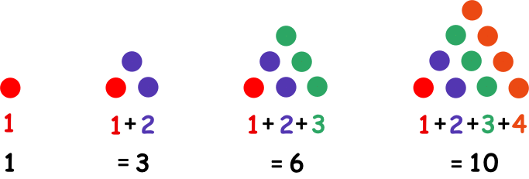
Triangular numbers
Base case
i=4
triangle(3)=3+triangle(2)
i=3
triangle(1)=1
i=2
i=1
Recursive formula:
triangle(2)=2+triangle(1)
triangle(4)=4+triangle(3)
triangle(n)=
n+triangle(n-1)

Slide 4
Recursive algorithm for triangular numbers
TRACE!!
Algorithm: triangle(n)
Requires: a positive integer n>0
Returns: sum of 1+2+3+…+n
triangle(4)
END
=10
n=4
n != 1
return 4+triangle(3)
=4+6
triangle(3)
backtracking
if n == 1 then
2. return 1 //base case
3. else
4. return n+triangle(n-1)//recursive call
5. endif
return 3+triangle(2)
n=3
n != 1
=3+3
triangle(2)
n=2
n != 1
return 2+triangle(1)
=2+1
triangle(1)
Base case
n=1
n == 1
return 1
Recursive calls STOP!!

Slide 5

Recursive Power function $(x^{n})$
x^{n} = 1 if n = 0
= x * x^{n-1} if n>0
5³ = 5 * 5²
5² = 5 * 5¹
5¹ = 5 * 5⁰
5⁰ = 1
Base case!
Recursive formula
backtracking

Slide 6

Recursive algorithm for power function
Algorithm:
Requires:
Returns:
power(x,n)
two numbers, x󠅮$∈ℝ$, n $∈ℤ^{≥0}$
the value of x^{n}
if n == 0 then
2. return 1 //base case
3. else
4. return n*power(x-1,n)//recursive call
5. endif
Bad recursive formula!! Doesn’t approach the base case
infinite recursion!!

Slide 7
Recursive algorithm for power function
Algorithm:
Requires:
Returns:
power(x,n)
two numbers, x󠅮$∈ℝ$, n $∈ℤ^{≥0}$
the value of x^{n}
if n == 0 then
2. return 1 //base case
3. else
4. return x*power(x,n-1)//recursive call
5. endif
Correct!

Slide 8
Greatest common divisor (GCD)
gcd: greatest common divisor.
gcd(32,24) = 8
divisors of 32: 1,2,4,8,16,32
divisors of 24: 1,2,3,4,6,8,12,24
∴ the greatest common divisor(gcd) is 8
Can you propose an algorithm for finding gcd(x,y)?

Slide 9
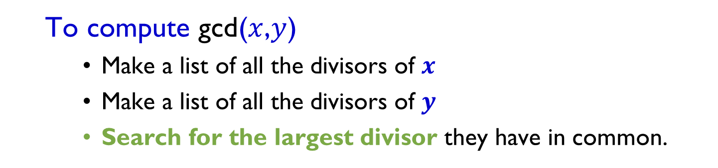
Greatest common divisor (gcd)
Is
This
Algorithm?
Efficient?
To compute gcd($x$,$y$)
Make a list of all the divisors of $x$
Make a list of all the divisors of $y$
Search for the largest divisor they have in common.
Too complicated
For example:
Divisors of 12 : 1, 2, 3, 4, 6, 12
Divisors of 14 : 1, 2, 7, 14
∴ the greatest common divisor of 12 and 14 is 2
What if x and y are
very large numbers?

Slide 10
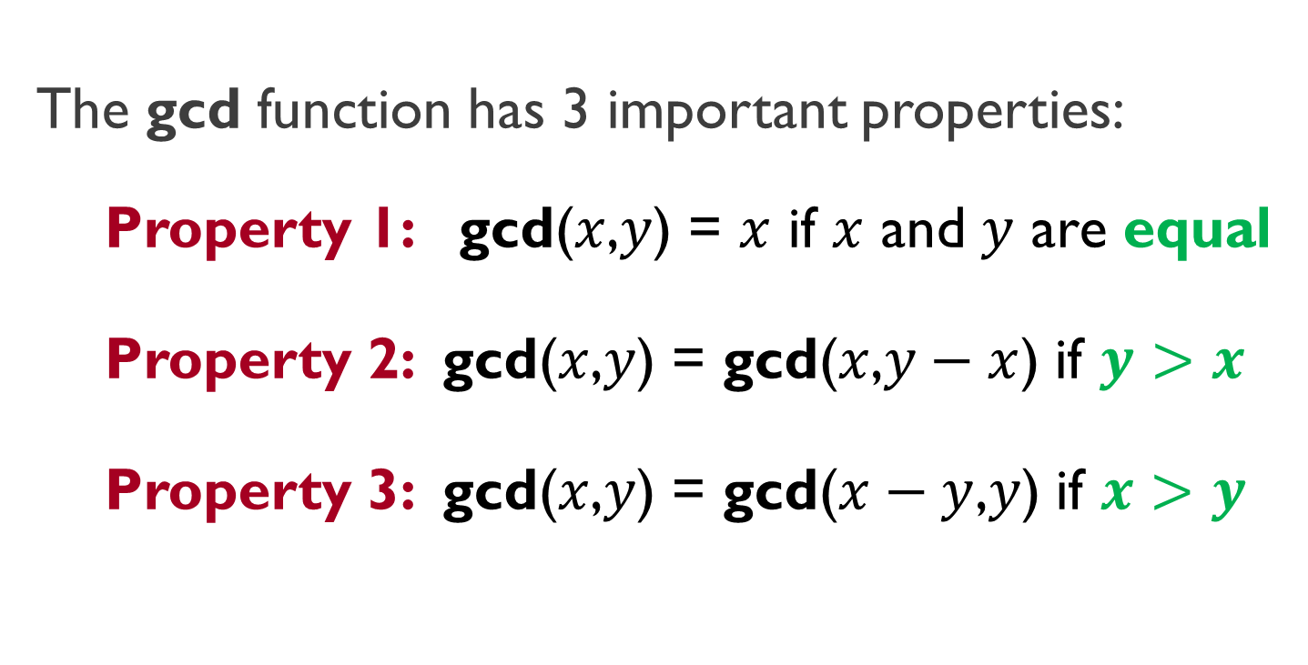
Mathematical properties of gcd
The gcd function has 3 important properties:
Property 1: gcd($x$,$y$) = $x$ if $x$ and $y$ are equal
Property 2: gcd($x$,$y$) = gcd($x$,$y−x$) if $y>x$
Property 3: gcd($x$,$y$) = gcd($x−y$,$y$) if $x>y$
Base case
Recursive calls
RECURSION??

Slide 11
Recursive algorithm for gcd
Algorithm:
Requires:
Returns:
gcd(x,y)
two positive integers, x,y>0
gcd(32,12); 32>12
a positive integer, (the greatest common divisor of x,y)
gcd(20,12); 20>12
if x == y then
2. return x //base case
3. elseif x > y
4. return gcd(x-y,y)//recursive call
5. else
return gcd(x,y-x)//recursive call
7. endif
gcd(8,12); 8<12
gcd(8,4); 8>4
gcd(4,4); 4==4
Base case
return 4
END!
No backtracking??
Check the mathematical properties of gcd(x,y)
gcd(32,12)=gcd(20,12)=gcd(8,12)=gcd(8,4)=gcd(4,4)=4

Slide 12
Homework: Euclid’s algorithm
Can you improve the algorithm for gcd(x,y)?
Can you make it perform faster?
Search for EUCLID’s ALGORITHM
online and write a recursive algorithm for it.

